Slide 1

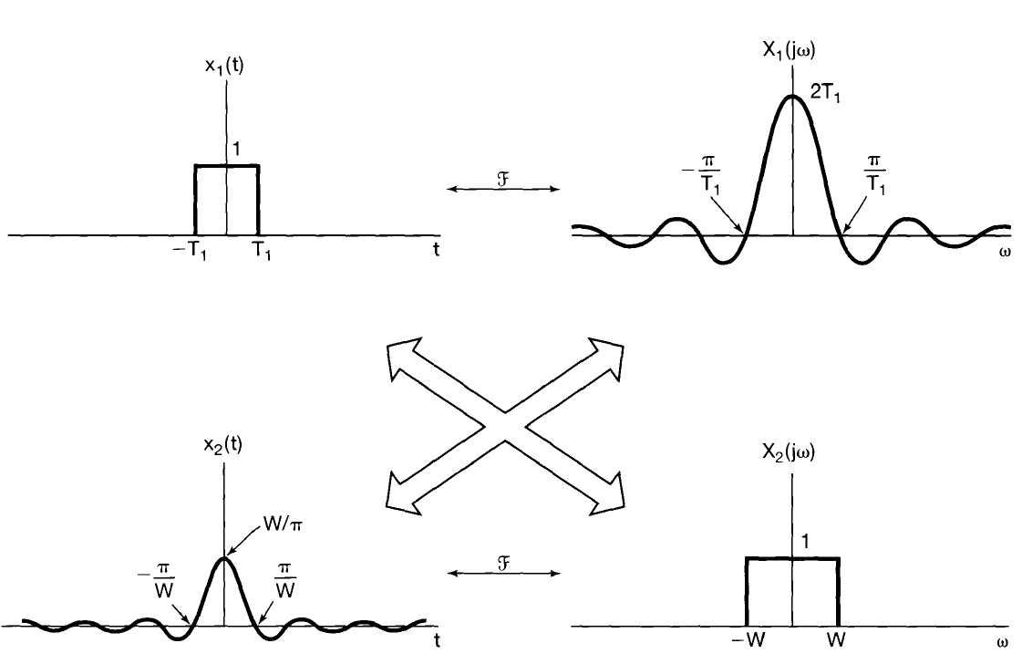
Properties of continuous-time Fourier Transform
Duality

Slide 2
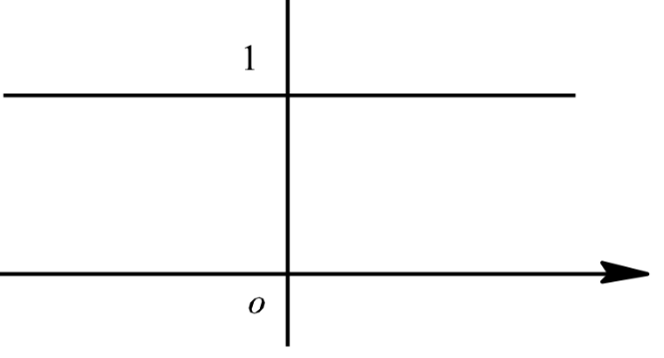

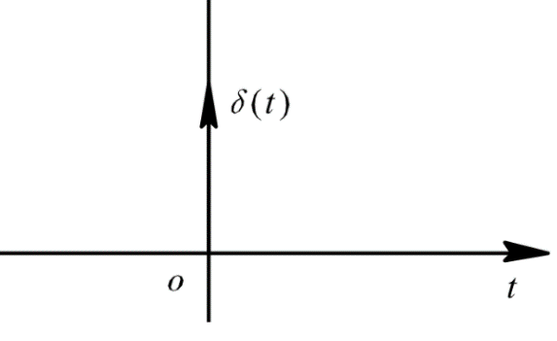




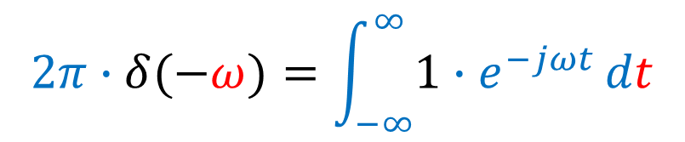

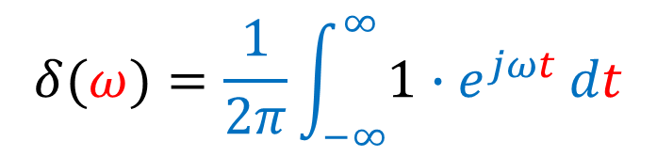

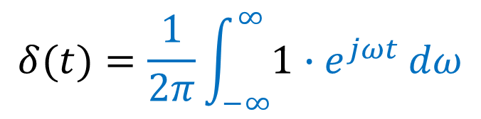


Properties of continuous-time Fourier Transform
Example
$$x_{1}\left(t\right)$$
$$X_{1}\left(jω\right)$$
②
$$δ(t)=\frac{1}{2π}\int_{−∞}^{∞}{1∙e^{jωt}}dω$$
③
$$δ(ω)=\frac{1}{2π}\int_{−∞}^{∞}{1∙e^{jωt}}dt$$
①
$$X_{2}\left(jω\right)$$
$$x_{2}\left(t\right)$$
②
③
$$2π∙δ(−ω)=\int_{−∞}^{∞}{1∙e^{−jωt}}dt$$
$$ℱ$$
$$δ\left(t\right)$$
$$1$$

Slide 3
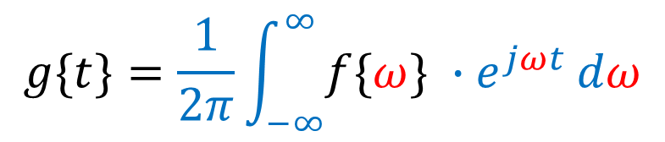







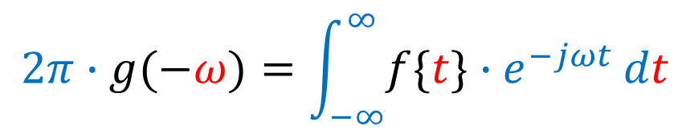
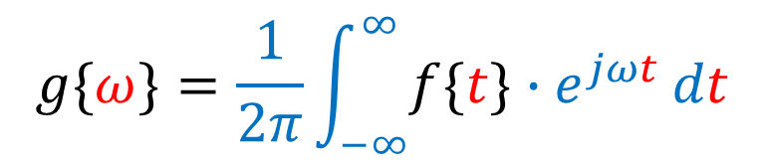
Properties of continuous-time Fourier Transform
Example
$$x_{1}\left(t\right)=f\{t\}$$
$$X_{1}\left(jω\right)=\text{2}\text{π}\text{∙}\text{g}\text{(−}\text{ω}\text{)}$$
②
$$g\{t\}=\frac{1}{2π}\int_{−∞}^{∞}{f\{ω\} ∙e^{jωt}}dω$$
③
$$g\{ω\}=\frac{1}{2π}\int_{−∞}^{∞}{f\{t\}∙e^{jωt}}dt$$
① t=$ω$
$$x_{2}\left(t\right)=g\{t\}$$
$$X_{2}\left(jω\right)=f\{ω\}$$
②
③
$$2π∙g(−ω)=\int_{−∞}^{∞}{f\{t\}∙e^{−jωt}}dt$$
$$ℱ$$
$$g\left(t\right)$$
$$f\{ω\}$$

Slide 4








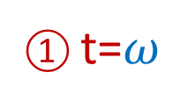

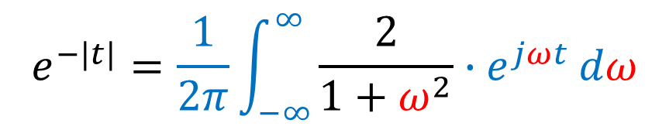


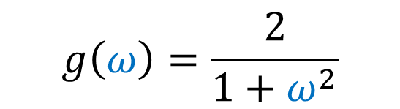

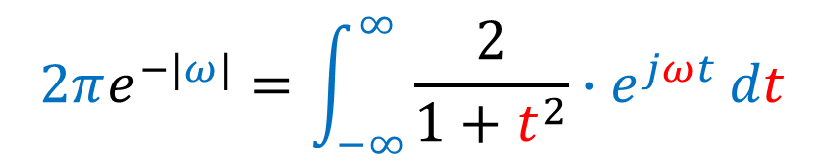
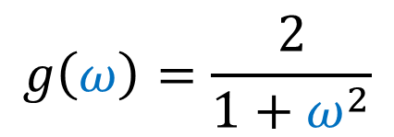
Properties of continuous-time Fourier Transform
$$g\left(t\right)=\frac{2}{1+t^{2}}$$
Example
$$G\left(jω\right)=?$$
Solution: calculate $G\left(jω\right)$ is difficult; use duality property
$$g\left(ω\right)=\frac{2}{1+ω^{2}}$$
① t=$ω$
$$g\left(t\right)=\frac{2}{1+t^{2}}$$
$$∴G\left(jω\right)=2πe^{−|−ω|}$$
②
③
$$e^{−|t|}=\frac{1}{2π}\int_{−∞}^{∞}{\frac{2}{1+ω^{2}}∙e^{jωt}}dω$$
① t=$ω$
$$2πe^{−|ω|}=\int_{−∞}^{∞}{\frac{2}{1+t^{2}}∙e^{jωt}}dt$$
$$g\left(ω\right)=\frac{2}{1+ω^{2}}$$
②
$$e^{−|t|}$$
$$\frac{2}{1+t^{2}}$$
$$ℱ$$
$$ℱ$$
$$2πe^{−|ω|}$$
$$e^{−a|t|}$$
$$2a/(a^{2}+ω^{2})$$
③

